Slide 1
Grain sorghum an alternative crop for Barbados?
By
Gerald Proverbs

Slide 2
Origin
Sorghum is a plant native to Africa.
5th most important cereal crop in food production.
Dietary staple of more than 500 million people living in 30 countries around the world.

Slide 3
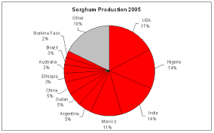
Sorghum production by country

Slide 4
Major producers
70 million tons produced annually on 125 million acres
12 million tons produced in USA
10 million tons produced in both Nigeria and India
8.5 million tons produced in Mexico
7 million tons in Argentina, China and Sudan
2.2 million tons in Australia

Slide 5
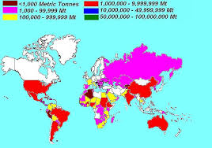
Sorghum distribution map

Slide 6
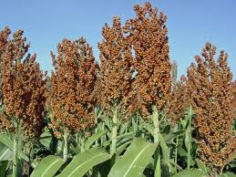
The plant
Sorghum (S. bicolour) is a member of the grass family, Graminae.
Since 1961 production has risen by 45% but the land area used to grow it has decreased.

Slide 7
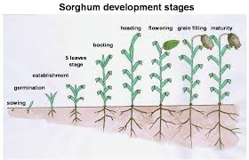
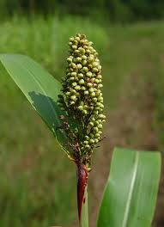
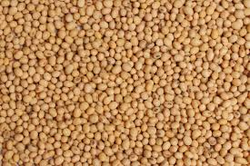
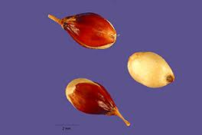
The Sorghum plant

Slide 8
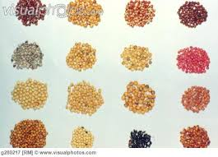
Various seed colours

Slide 9
Seed suppliers
Several seed suppliers including the US, South Africa and Australia.
Majority are hybrid cvs, e.g. DuPont Pioneer has 20+ hybrids and DeKalb has 10.
ICRISAT in India produces pure seed which means the farmers can keep part of their crop for replanting.

Slide 10
Cultivar selection
Cultivars or lines with a wide adaptability - good first choice for Barbados.
Early cultivars bloom in 55-60 days at a height of 30-36 inches and are ready for harvesting in 90-105 days.
Late maturing cultivars bloom in 75-80 days at a height of 50-60 inches and are mature at 120-125 days.

Slide 11
Planting rate & germination
Sorghum is very small seeded and should not be planted deeper than 1 inch with
4-6 seeds per inch.
Seeding rate is 27,000 - 41,000 seeds
per acre.
Over 80% of the seed will germinate at 25°C in 7-10 days.
Will achieve optimum growth and development at 27-30°C.

Slide 12
Rainfall requirement
Average rainfall for good production
In Australia 16-35 inches
In South Africa 12-30 inches
In Texas, USA 12-25 inches

Slide 13
Weed control
Weed control is crucial during the first
40-60 days.
Weeds can be eliminated mechanically or chemically using liquid or granular herbicides.

Slide 14
Harvesting & storage
Sorghum can be harvested at a moderately high grain moisture
(18-22%).
Have to artificially dry the grain to reduce moisture level to 12-13% before storage.
Losses when mechanically harvested run about 10%.

Slide 15
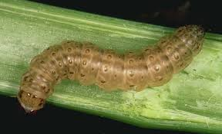
Insect pest control
Integrated pest management and selective insecticides depending on pest. Eg Fall army worm

Slide 16
Grain yields
Average yields:
Australia and South Africa - yield
2 tons per acre.
Texas USA - yield between 2.4 and 2.7 tons per acre.

Slide 17
Comparison of nutritive value
Protein level:
Sorghum 9%
corn 8-10%
cassava 4-6%
Energy level:
sorghum 2900 kcal/lb
corn 3200 kcal/lb
cassava 3800 kcal/lb

Slide 18
Water requirement
Water requirement : To produce 1 ton of crop:
sorghum 10 tons
corn 20 tons
Cassava 18 tons

Slide 19
Moisture content of crop
Moisture content at harvest:
sorghum 18-22 %
corn 14-20 %
cassava 65-75 %

Slide 20
When and where to plant
Potential for farmers to produce two sorghum crops per year.
Ist crop planted in May/June, harvested end of August.
2nd crop planted in December, harvested April.
Crop most suited to lands in St Philip,
St Peter and St Lucy.

Slide 21
The future?
There is a future for growing sorghum:
There is a ready market for the grain
Pinnacle feeds imports about 25,000 tons of corn annually.
Can we grow it competitively?
Only R&D can answer this question.
How long will it take to find out?
No more than five years.

Slide 22
The future
Present price of corn at US terminal is US $3.50 per bushel or US $125 per ton.
Additional costs: grain treatment, loading vessel, sea freight, unloading vessel, port fees, elevator fees and inland freight.
Price of corn delivered to Pinnacle Feeds
US $250/ton.
Approximately 16,000 acres needed to produce sorghum.

Slide 23
Quote - JFKennedy
Farmers deserve praise not condemnation and their efficiency should be cause for gratitude not something for which they are penalized.

Slide 24
Thank you

