Slide 1
Sweet Potato Processing
Armag Farms Ltd launched “Sunbury Harvest” fries in January 2014 to:
Provide convenient product for busy individuals as well as restaurants
Provide healthy alternative to white potato fries
Reduce food import bill
Increase sales of sweet potato

Slide 2
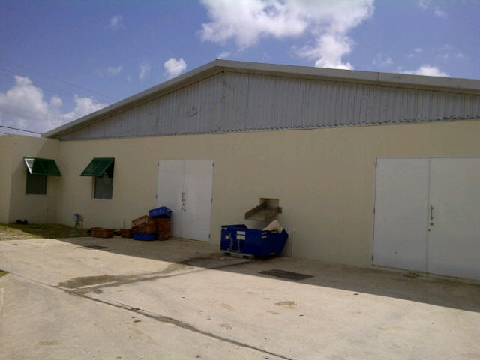
Armag Manufacturing Ltd.

Slide 3
Difficulties Encountered
Sourcing suitably sized & priced quality equipment that would link together to form a smooth running production line

Slide 4
Production process
Wash, peel, cut into desired shape
Steam blanche (precook)
Ice bath to stop cooking process
Grade immediately
Blast freeze
Package & store.

Slide 5
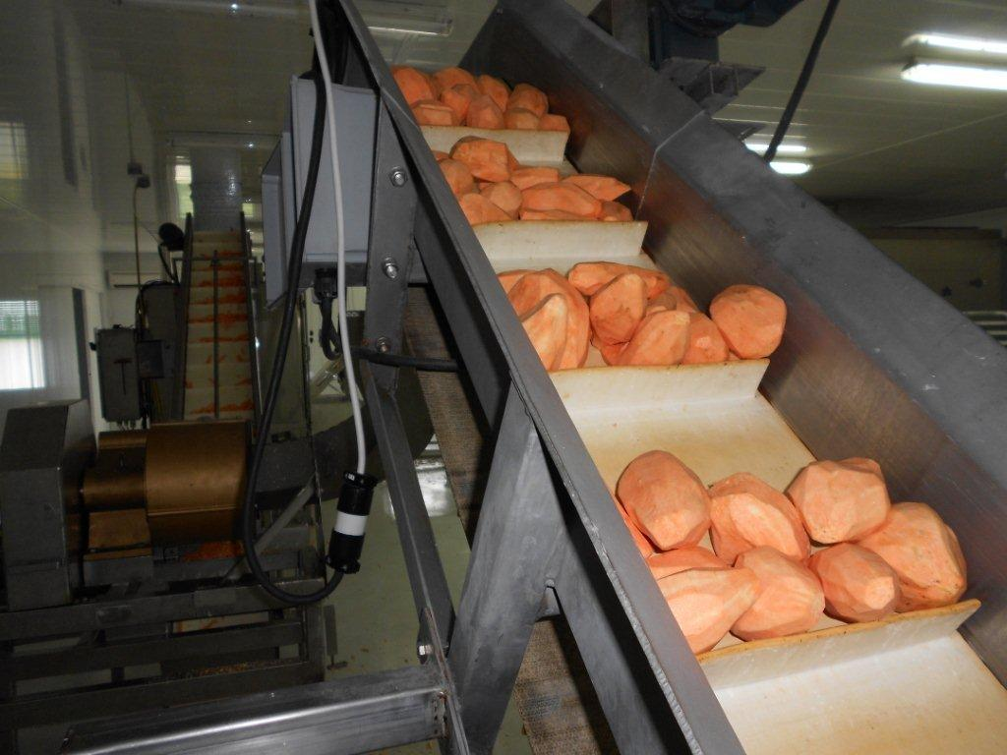
Peeled ,washed potatoes

Slide 6
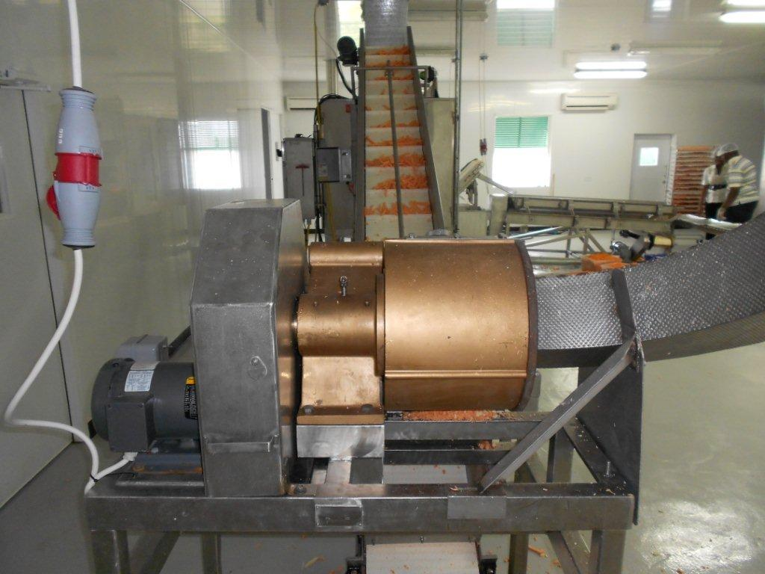
Cutting & Transfer to Steam Blancher.
Font, size, and color for text have been formatted for you in the Slide Master
Use the color palette shown below
See next slide for additional guidelines
Hyperlink color: www.microsoft.com
Sample Fill
Sample Fill
Sample Fill
Sample Fill
Sample Fill
Sample Fill

Slide 7
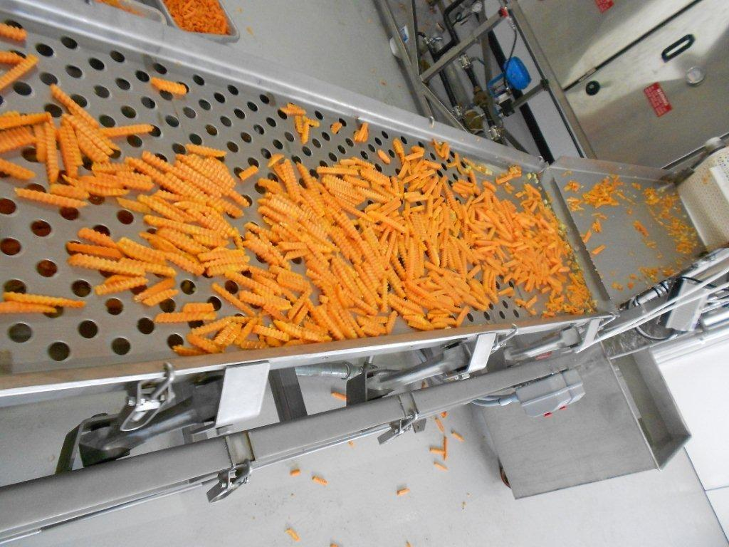
Finished Fries on Grader belt Subtitle color
Example of a slide with a subhead
Set the slide title in “title case”
Set subheads in “sentence case”
Generally set subhead to 36pt or smaller so it will fit on a single line
The subhead color is defined for this template but must be selected. In PowerPoint 2007, it is the fourth font color from the left

Slide 8
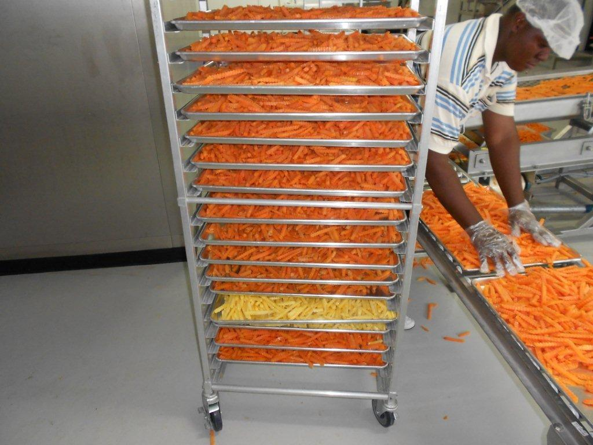
Stacked fries ready for blast freezer

Slide 9
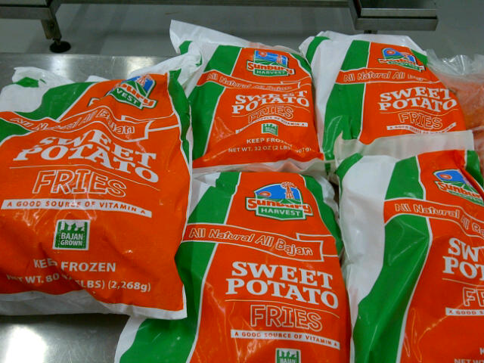
Packaged product in supermarket

Slide 10
Response to Product
Slow at first but over the last few months things have improved drastically as the product gains “respect”
The word has spread that they are truly fresher, tastier & cheaper than the foreign choice.
Also the health benefit of sweet potato over English/Irish potato is gaining strength.

Slide 11
Problems to be solved
Reduce cost of energy in the operation
Get the product accepted by local consumers & food industry players.
Competition from drastically under- tariffed foreign imports that were coming in (& may still be).

Slide 12
Future Products
Yam, cassava, breadfruit and plantain.

